Slide 1
A brief introduction to

Slide 2
What is REPACC?
REPACC is a retrospective multi-centre service evaluation with 3 main objectives
1
2
3
To describe the current models of enhanced perioperative care within the UK
To identify the organisational factors associated with of on-the-day cancellation
To assess the effect of different models of enhanced care on measures of organisational efficiency
Notes:
This is a multicentre service evaluation comprised of 2 components:
A retrospective analysis of on-the-day cancellation rates, and several other measures of organisational efficiency, in patients referred to enhanced care facilities for post-operative care between 01/09/23 and 30/11/23.
A qualitative appraisal of the structure of enhanced care services at participating centres.
Objectives
To describe the current models of enhanced care operational within the UK.
To identify the structural and organisational factors associated with rate of on-the-day cancellation due to lack of an enhanced care bed space.
To evaluate the effect of different models of enhanced care on wider measures of organisational efficiency.
Inclusion criteria
Participants will be included if they meet the following criteria:
Aged 18 years or older.
Undergoing elective or expedited surgery (NCEPOD 3 and 4) [11] between 01/09/23 and 30/11/23.
Referred for a post-operative enhanced care bed.
Decision made to refer for an enhanced care was made before the scheduled time of the procedure.
Exclusion criteria
Participants will be excluded if they meet the following criteria:
Undergoing emergency surgery (NCEPOD 1 and 2, or Unclassified) [11].
Referred for an enhanced care bed intra-operatively or post-operatively.
Undergoing obstetric, cardiothoracic or neurosurgery.
Died intra-operatively.
Receiving surgery for the purpose of organ donation.

Slide 3
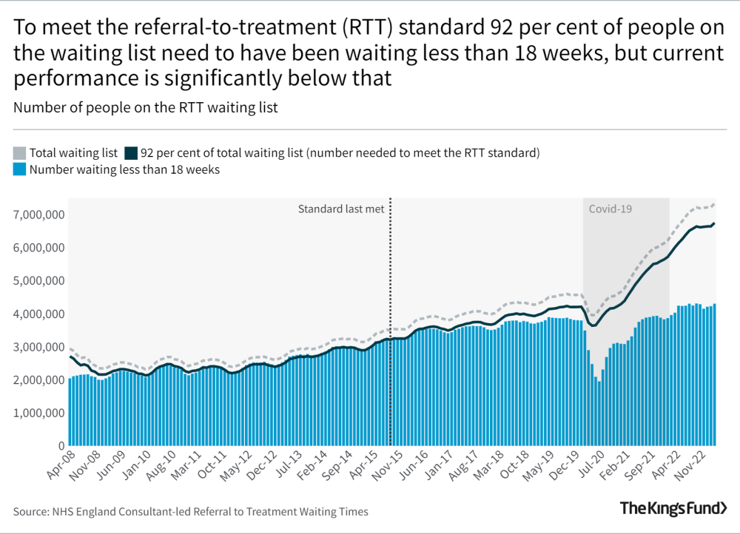
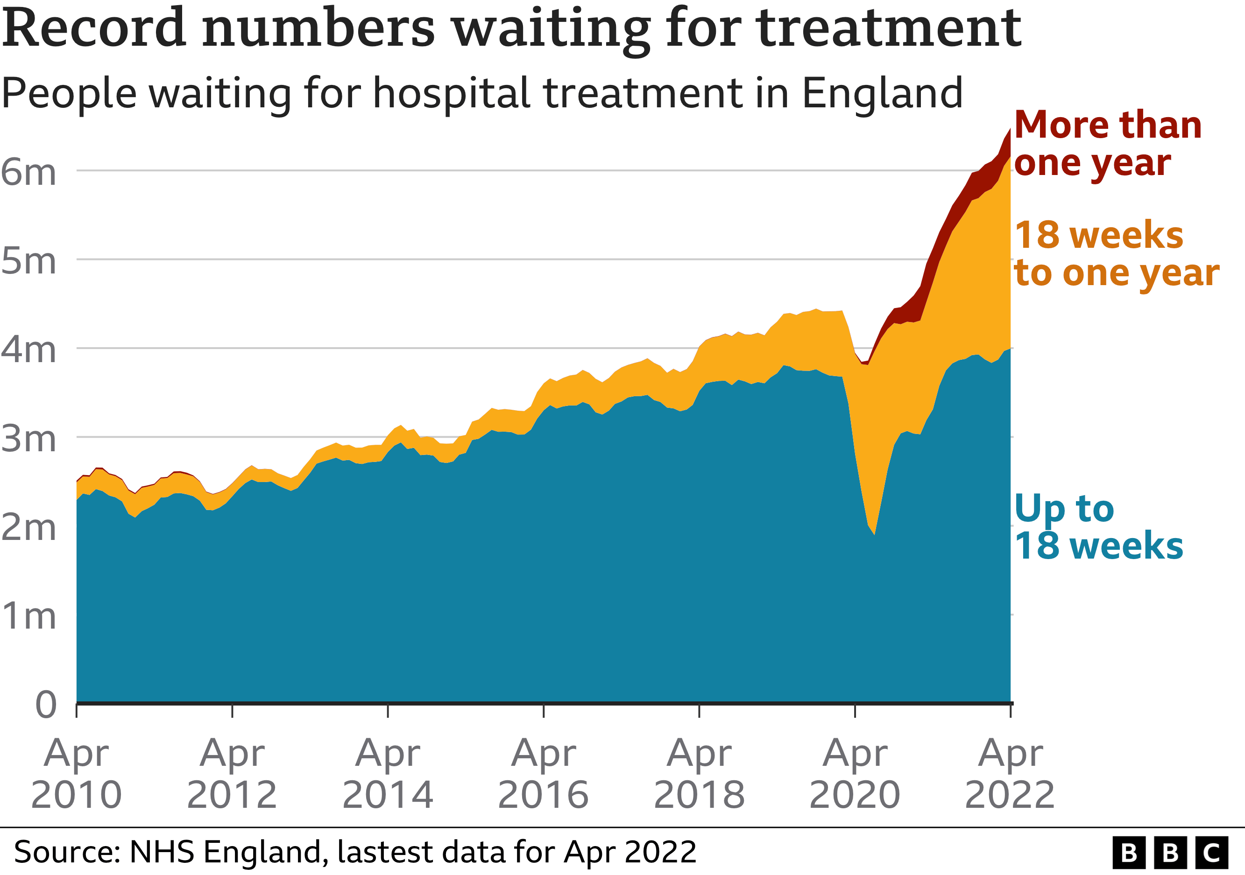
Why are we studying this?
Surgical waiting lists are at an all-time high, yet there were still 18,749 surgeries cancelled between July and September 2023 in the UK
Notes:
Delivery of post-operative critical care for high-risk surgical patients represents a significant challenge within the NHS due in part to high bed occupancy rates [1]. Rates of on-the-day cancellation of elective procedures, and deferral of treatment until outside of the recommended 28-day window post-cancellation, due to absence of an appropriate post-operative destination are high, at a time when surgical waiting list pressures are at unprecedented levels [2-3].
Bed occupancy is also high
91.9% of general and acute beds occupied in July 2023
74.1% of critical care beds occupied in July 2023

Slide 4
Why are we studying this?
The requirement for a post-operative critical care bed predicts on the day cancellation (OR=2.92)
Enhanced care facilities (PACU/OIR) were designed to relieve pressure on critical care, in part to address this issue, but hospitals with these units are associated with higher cancellation rates (OR=1.62)
The question is, do enhanced care facilities perform the task they were designed to perform?
Notes:
The requirement for a post-operative critical care bed is independently predictive of on-the-day cancellation of elective surgery in the UK [4]. In order to reduce unnecessary cancellation, and relieve pressure on critical care beds, new models of care such as Post-Anaesthetic Care (PACU) and Overnight Intensive Recovery (OIR) units have evolved [5-6].
The faculty of intensive care medicine has advocated for funding of these facilities, collating an evidence base comprised of a heterogeneous sample of facilities whose introduction have led, in single centre cohorts, to improvements in organisational efficiency and certain clinical outcomes [7-8]. In 2019, approximately 55% of surveyed organisations in the UK had some form of intermediate enhanced care facility, such as PACU or OIR, for the care of high-risk post-operative patients [9]. These were predominantly anaesthetist led, caring for a median of 4 patients, with just less than 30% of institutions having ring-fenced bedspaces for this purpose.
Whilst intuitively these models of care stand to improve organisational efficiency, there is speculation that reduced clinical and risk score thresholds for admission to these intermediate units may serve to increase the likelihood of on-the-day cancellation if these services are over-burdened. The finding that institutions with an operational PACU or OIR demonstrate significantly higher rates of on-the-day cancellation adds weight to this concern [4].
Presently, there are no resources that describe the current status of enhanced care services operational within the UK. It is therefore unknown whether the recommendations made by the faculty of intensive care medicine in 2020, concerning the development of enhanced care services, have been followed [10]. Furthermore, whilst these models of care are increasingly prevalent [5], there is a paucity of literature addressing the organisational impacts of their introduction, or indeed which models of care are most effective in reducing systemic pressure.

Slide 5
Why are we asking for help?
We need to gather as much information as we can about the structure of enhanced care services in the UK. To do this we need to involve as many hospitals as possible!
From each hospital we will need:
A survey describing the structure of enhanced care
A time-series of the number of operations, referrals and admissions to enhanced care
A patient level analysis of those referred to enhanced care
Notes:
See protocol for planned analysis

Slide 6
What will I get for being involved?
Key benefits include:
Recognition as a collaborative author on all future publications
A certificate* for your professional portfolio that can contribute to both research and quality improvement domains
Involvement will fulfil the yearly audit training requirement
A chance to influence future practice in a field that is rapidly evolving in anaesthesia and critical care
*Trainee leads will be recognised as such on their certificates

Slide 7
How will we collect data?
Data collection will require investigators to:
Complete a survey describing the structure of enhanced care at your institution.
Create a time-series of the number of operations performed, cancellations, referrals and admissions to enhanced care for each day of the 3-month study period.
Formulate a list of all of the patients who were referred to enhanced care pre-operatively, and follow up their procedure details, the reasons for their referral, and cancellation details.

Slide 8
How will we collect data?
Roughly 80% of this data is coded and does not require manual collection
We have created a site setup guide that can be given directly to your clinical informatics team to source this information
Notes:
All CRFs have been designed alongside the clinical informatics team to be fairly self-explanatory to teams at other sites
The “Site Setup Guide” provides a detailed step-by-step walkthrough of all study activities

Slide 9
Who will be involved?
Each site will need to nominate a…
Consultant Supervisor
Trainee
Lead
Team of trainee investigators
Notes:
Smaller sites will need a trainee lead and 1-2 co-investigators
Larger sites will need a trainee lead and 2-3 co-investigators
Consultant supervisors can, and may be best placed to, assist with completing the survey component

Slide 10
How long will this take?
Depending on the size of your hospital, and the number in your team, our pilot studies suggest each team member should expect the following time commitment:
Consultant supervisor – <1 full day
Trainee lead – 3-4 full days with some additional time spent emailing and coordinating
Trainee investigators – 1-2 full days of data collection
*This can be completed within educational development time
Notes:
These timescales have been derived from pilot data from 2 sites; one DGH and one busy tertiary centre

Slide 11
How do I get involved?
If you are interested or would like more information, please get in touch!
http://www.uk-plan.net/REPACC
repacc.plan@gmail.com
Notes:
See next slides for FAQs

Slide 12
Frequently Asked Questions
Who is running REPACC?
REPACC is being run by a trainee research network known as the Pan-London Perioperative Audit & Research Network (PLAN). The lead site is Kingston Hospital.
When will data collection take place?
Data collection will begin in March 2024 and will run over an estimated 6-month period. As all of the data collection is retrospective, covering the period between 01/09/23-31/11/23, there is no formal start or end date for this process.
Is ethical approval required at my site?
No, REPACC is registered as a service evaluation and therefore does not require ethical approval.

Slide 13
Frequently Asked Questions
Is patient consent required to collect the data?
No, this project is being run as a service evaluation. All recorded information is anonymised, and personally identifiable information will only be accessed by the direct care team, therefore, patient consent will not be sought. Local investigators are not required to have completed Good Clinical Practice (GCP) certification.
How will data be stored and shared?
Anonymised data will be shared between NHS email accounts only. No personally identifiable information will be recorded, however documentation linking hospital to study IDs should be stored on encrypted drives as specified in the protocol. Please refer to the protocol and data collection guide for a full description of our information governance measures.

Slide 14
Frequently Asked Questions
My hospital doesn’t have a PACU/OIR, can I still be involved? Absolutely! We are interested in seeing what happens in hospitals with and without these models of care. Our analysis will be much more interesting if we can compare sites without these units to those that have them.
My hospital only uses paper notes, how do I approach the data collection process?
We have provided some tips on how to approach this in our site setup guide. The main modification is to perform all of the note appraisal at the same time, which means several stages the data collection process are performed in tandem.

